Slide 1
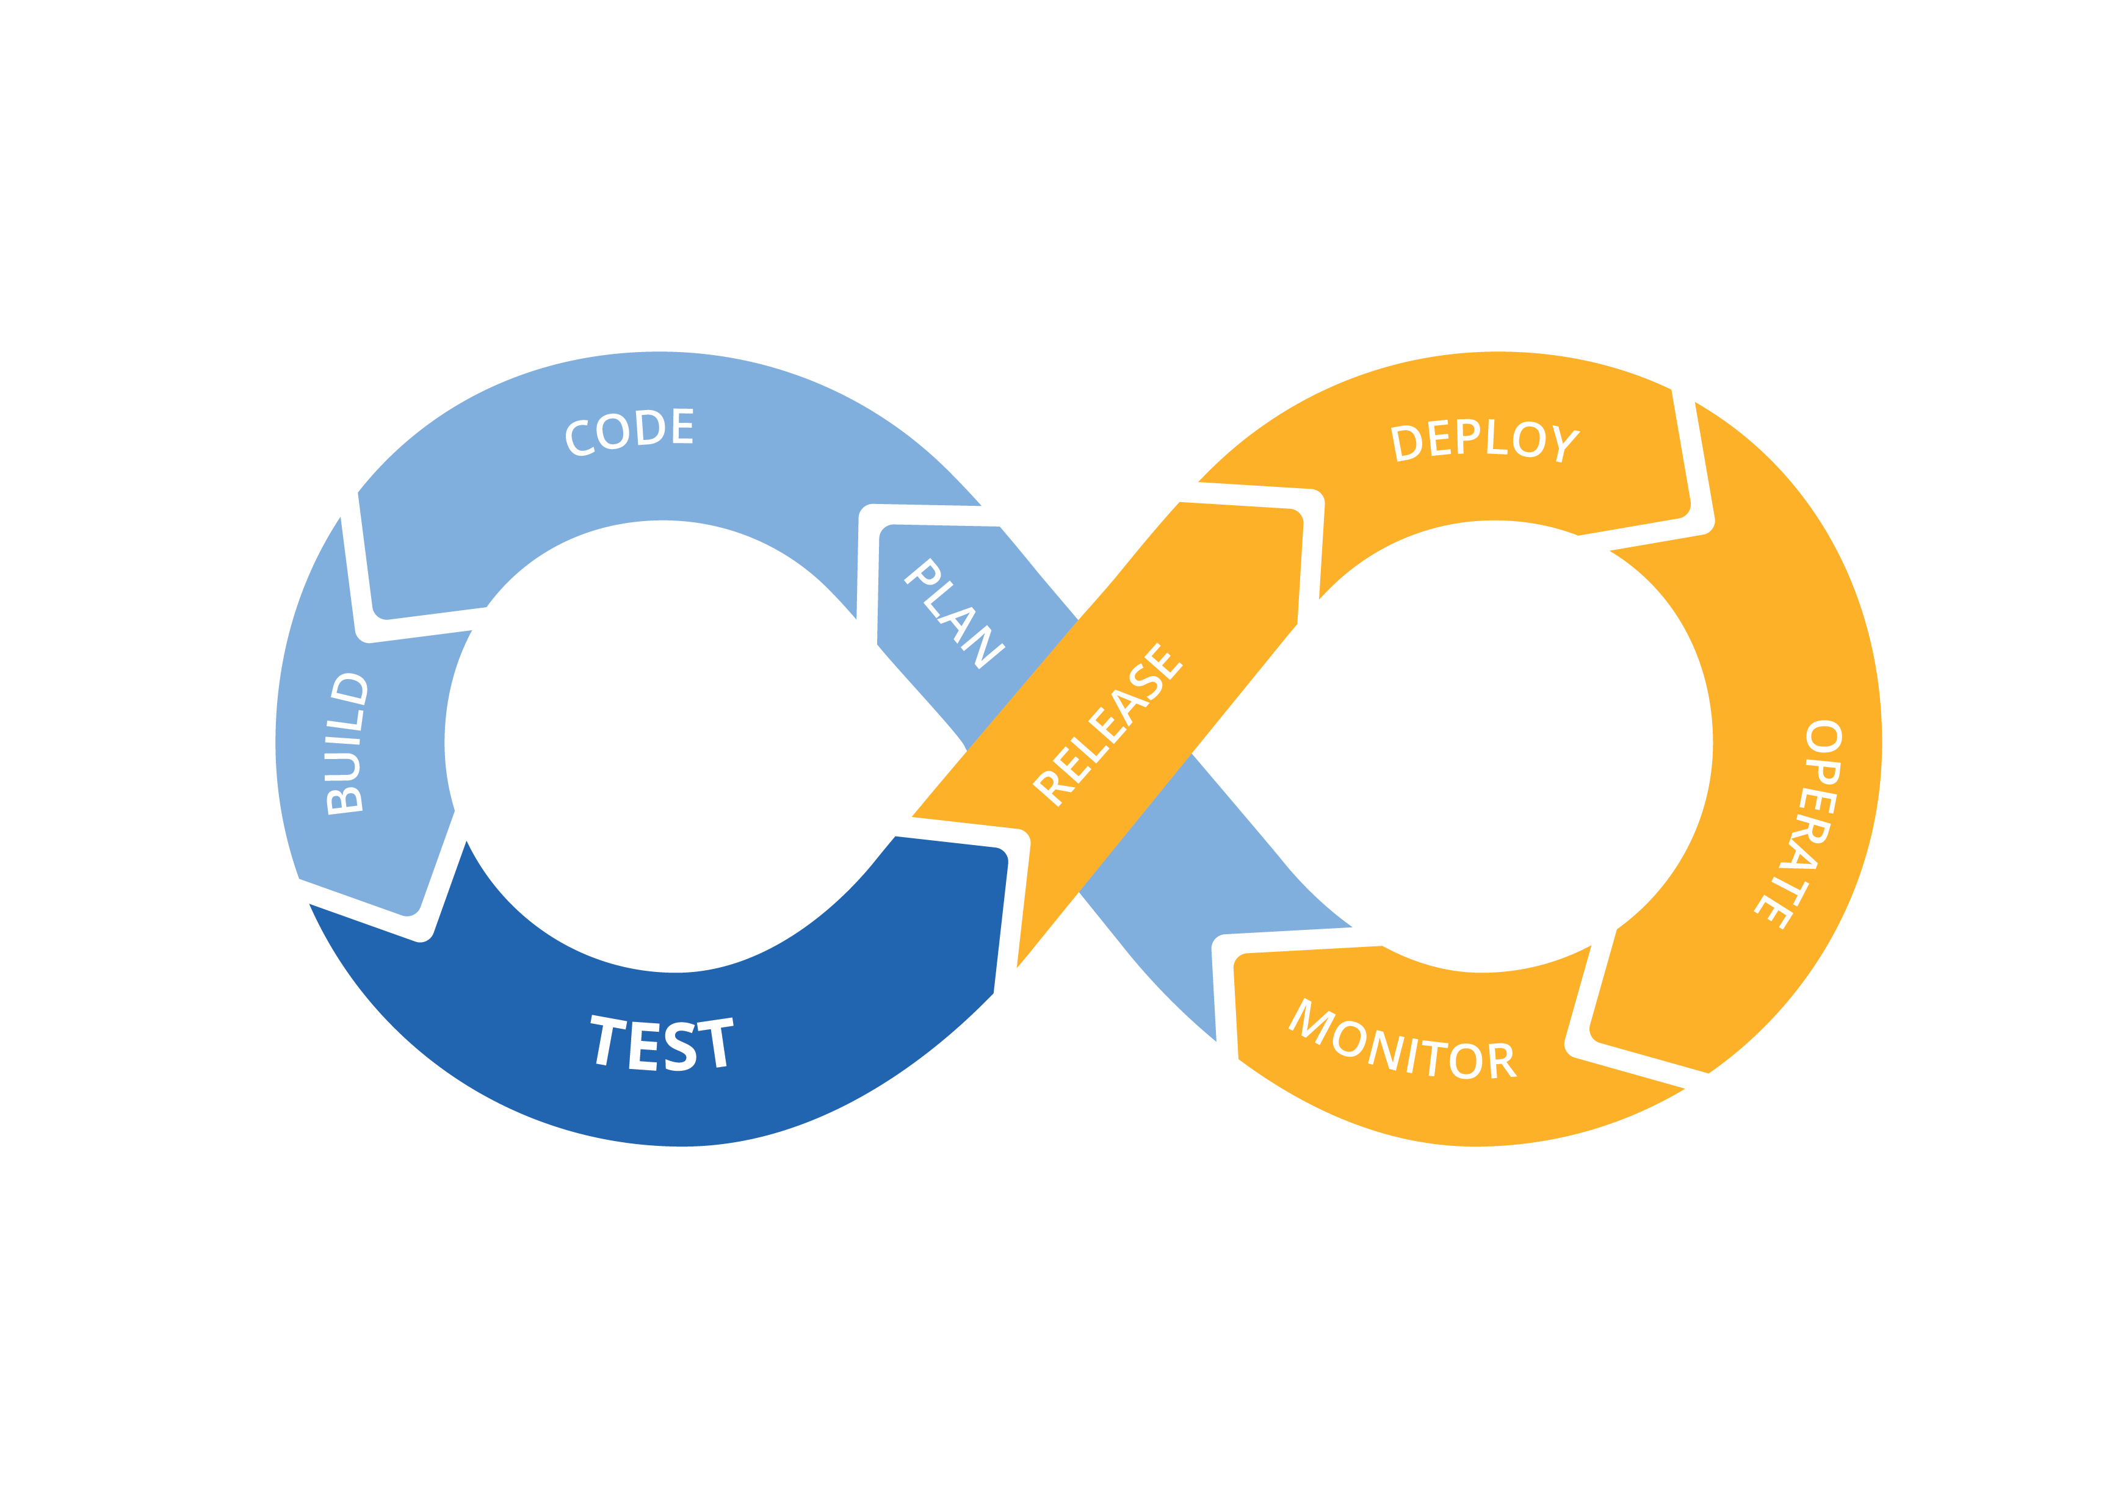



Spring 2018 | Rock the Blockchain Vote
Licensing
DevOps
Researching licenses information
Ensuring we are following license requirements
MIT
GNU Public License
Python
Oracle
Flask
SQLAlchemy
Jack Hess, Mason Johnson,
Archana Satyamurthy, Kay Seidel,
Nick Stegelman, Jacob Wild
jhess9@uwyo.edu, mjohn107@uwyo.edu , asatyamu@uwyo.edu, kseidel1@uwyo.edu, nstegelm@uwyo.edu, jwild1@uwyo.edu
Motivation and Abstract
Limitations and Challenges
Research and assistance with system integration.
Documentation for teams.
Licensing
Security inspection and research
Known issues with libraries
Software deployment
Acquiring computing resources for the teams
Streamlining
Assisting in any other way that helped the teams get from inception to deployment
Receiving information to move forward in our projects
Understanding the requested information we are supplying to the groups
Understanding each groups project
The size of the overall project vs. amount of people working on it
Deliverables
DevOps Life Cycle
Licensing
Repos Accessibility
User Manual(s)
The product
Future Work: what we could enhance
Time, materials/resources, money spent
Pizza
AWS
Markdown File
Overall Objectives
Description of how we chose teams
The purpose of each team
Time Sheets
Invested time and effort
Technical documentation
Code Base, build and run the system (Chapter 1 of user manual)
Infrastructure
Conclusions and Future Work
AWS
Hardware
DevOps Requirement for large groups
Ensure unification of documentation
Acknowledgements:
Mike Borowczak, CEDAR, AWS
This poster made possible by:
UWYO College of Engineering & Applied Science, UWYO Computer Science Department, and UWYO CEDAR.

